Slide 1
Automated Detection of Software Bugs and Vulnerabilities in Linux
Silvio Cesare
Deakin University
<silvio.cesare@gmail.com>

Slide 2
Who am I and where did this talk come from?
PhD student at Deakin University.
Research
Malware classification using static analysis
Bug and vulnerability detection
Presented at Blackhat, Cansecwest, Ruxcon.
This presentation is some of my research.

Slide 3
Other Research
Combine decompilation with static analysis for bug finding.
Abstract Interpretation.
Has found bugs and vulns in Linux binaries.
Plan to submit research papers for publication.
Under active development.

Slide 4
Outline of this talk
Introduction
Problem Statement and Our Approach
Embedded Package Detection
Related Packages Detection
Vulnerability Detection from Embedded Clones
Cross Distribution Vulnerabilities
Evaluation and Discussion
Availability, Future Work and Conclusion

Slide 5
Introduction

Slide 6
Introduction
Software defects are major cause of internet insecurity.
Detecting software defects before the bad guys improves security.
Incorporating detection early in QA makes software more secure from the beginning.
Automated detection an important research area.

Slide 7
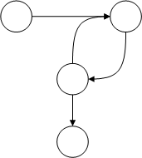
Traditional Formal Bug Detection Methods
Theorem Proving→
Axiomatic semantics
Hoare logic etc
Model Checking →
Static analysis
Abstract interpretation etc →

Slide 8
Embedded Package Clones
Developers may “embed” or “clone” code from 3rd party projects.
Statically link against external library.
Maintain an internal copy of a library’s source.
Fork a copy of a library’s source.
E.g., compression libraries, image processing libraries, parsers.

Slide 9
Embedding is bad practice
Linux package policies generally disallow.
Why?
2+ versions of library need to be maintained.
Bug fixes must be manually incorporated.
Old embedded libraries often insecure.

Slide 10
Example vulnerabilities
E.g., zlib vulnerability in 2005
Uncertainty of which Linux packages embed zlib.
Manual signatures generated to identify zlib.
Scan of Debian Linux package repository.
Many vulnerable packages.
More recently, libtiff 3.9.4 in April 2011.
How many packages are still vulnerable?

Slide 11
Manual signatures
Sigs based on version strings embedded in libraries.
E.g.
bzlib_private.h:#define BZ_VERSION "1.0.5, 10-Dec-2007"
tiffvers.h:#define TIFFLIB_VERSION_STR "LIBTIFF, Version 3.8.2\nCopyright (c) 1988-1996 Sam Leffler\nCopyright (c) 1991-1996 Silicon Graphics, Inc."
png.h:#define PNG_HEADER_VERSION_STRING \
" libpng version 1.2.27 - April 29, 2008\n"

Slide 12
Is it still a problem?
We made sigs for bzip2, libtiff <= 3.9.2, and libpng.
Scanned Debian and Fedora Linux.
Found 5 vulnerable packages.
Firefox embeds libpng, has had vulnerable windows of 3+ months.

Slide 13
Scale of the problem
Scale of the problem
10,000+ packages in Linux distributions.
Debian manually track 420 embedded packages.
Other distributions don’t track at all.
Automation
Manual tracking is a time consuming and challenging task.
A need to automatically identify embedded packages.
What bugs could we find automatically?

Slide 14
Our Contributions
We define the problem.
We propose algorithms to identify embedded packages.
We propose algorithms to infer outstanding vulnerabilities.
We implement a complete system
Results are useful and being used by vendors.
Identifies previously unknown vulnerabilities.

Slide 15
Related Work
Areas
Plagiarism Detection
Code Clone Detection
Approaches
Text streams
Tokens
Abstract Syntax Trees
Program Dependence Graphs

Slide 16
Problem Statement and Our Approach

Slide 17
Problem Statement
Determine if package A is embedded in package B.
Find clusters of packages that share code.
Infer vulnerabilities using advisories and embedded package relationships.

Slide 18
Our Approach
If a source package has the other package’s filenames as a subset, it is embedded.
Packages that share files are related. A graph of relationships has related packages as cliques.
Vulnerabilities
Packages that embed clones inherit their vulns.
Packages that share clones share vulns.
Equivalent packages between distros share vulns.

Slide 19
Embedded Package Detection

Slide 20
Filename Matching
Use source packages.
Filenames in source tend to be the same between software versions.
Filenames are a feature.
Ignore frequently used filenames, e.g. Makefile, README etc.

Slide 21
Example of Common Files
expat-2.0.1/lib | tla-1.3.5+dfsg/src/expat/lib/
amigaconfig.h
ascii.h | ascii.h
asciitab.h | asciitab.h
expat.dsp | expat.dsp
expat_external.h | expat_external.h
expat.h | expat.h
expat_static.dsp | expat_static.dsp
expatw.dsp | expatw.dsp
expatw_static.dsp | expatw_static.dsp
iasciitab.h | iasciitab.h
internal.h | internal.h
latin1tab.h | latin1tab.h
libexpat.def | libexpat.def
libexpatw.def | libexpatw.def
macconfig.h | macconfig.h
Makefile.MPW | Makefile.MPW
nametab.h | nametab.h
utf8tab.h | utf8tab.h
winconfig.h | winconfig.h
xmlparse.c | xmlparse.c
xmlrole.c | xmlrole.c
xmlrole.h | xmlrole.h
xmltok.c | xmltok.c
xmltok.h | xmltok.h
xmltok_impl.c | xmltok_impl.c
xmltok_impl.h | xmltok_impl.h
xmltok_ns.c | xmltok_ns.c

Slide 22
Detecting Embedded Packages
Treat source tree (filenames) of package as set.
Package A is embedded in package B
If majority of set A is a subset of set B
Set A is embedded in set B if

Slide 23
Related Packages Detection

Slide 24
Detecting Packages Sharing Code
Match file names.
Then, prune files using fuzzy hashing.
If content’s fuzzy hashes are similar, and packages share files, then two packages are related.
We use ssdeep to do the fuzzy hashing.

Slide 25
Detecting Packages Sharing Code
Package A and package B related if:
If two packages share at least x number of files with similar content.
Draw an undirected graph
Node is a package.
Edge between packages if they are related.

Slide 26
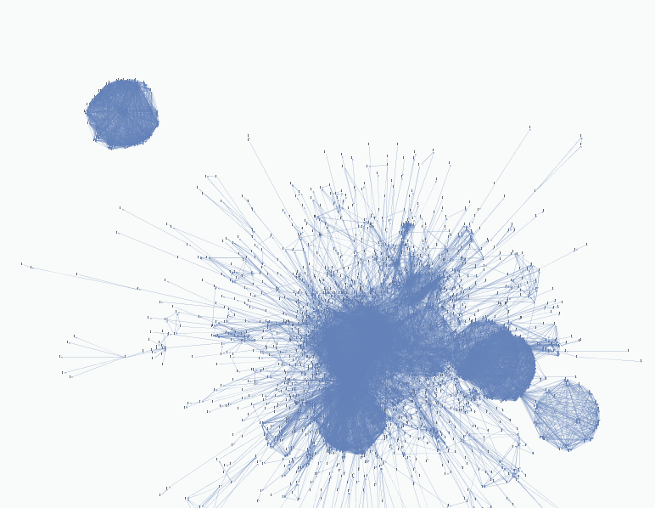
Graph of Fedora Linux

Slide 27
Maximal Cliques
A clique is a complete subgraph with edges between all nodes.
Cliques in graph identify that code is shared.
Maximal cliques identify the largest sets of packages that share the same code.
That is, they all embed the same code.

Slide 28
The Clique Problem
Finding maximal cliques in a graph is NP.
Hard to approximate.
Heuristics make it practical.
We use a tool called CFinder.

Slide 29
Vulnerability Detection from Embedded Clones

Slide 30
Detecting Vulnerabilities (1)
If package A is embedded in package B
Then
B inherits A’s vulnerabilities
So
Foreach vuln v in A
If v not in B
Report B as potentially vulnerable to v

Slide 31
Detecting Vulnerabilities (2)
If 80% of related packages are vulnerable to X.
Then remaining 20% probably also vulnerable.
But two packages have different CVEs for vulns.
Solution: If two vulns appear with 3 months of each other, then treat them as the same.

Slide 32
Cross Distribution Vulnerabilities

Slide 33
Detecting Vulnerabilities
If package A in Linux distribution D_{a} is vuln.
And there exists package B in distribution D_{b}
And B is a cross distro package to A.
Then package B is vuln.

Slide 34
Package Equivalence between Distros
Set similarity of filenames again.
One similarity measure is Jaccard Index.
Set A is similar to set B if
1-J(A,B) is metric which allows for faster than exhaustive similarity searches of a database.

Slide 35
Evaluation and Discussion

Slide 36
Implementation
Implemented a complete system.
6,000 LOC C++/Python/Shell scripting.
4,000 LOC Java visualization and navigation.

Slide 37
Filenames as a Feature
Is it a good feature?
National Vulnerability Database (NVD) references vulnerable filenames.
Summary: Off-by-one error in the __opiereadrec function in readrec.c in libopie in OPIE 2.4.1-test1 and earlier, as used on FreeBSD 6.4 through 8.1-PRERELEASE and other platforms, allows remote attackers to cause a denial of service (daemon crash) or possibly execute arbitrary code via a long username, as demonstrated by a long USER command to the FreeBSD 8.0 ftpd.

Slide 38
Finding Vulns from Filenames
Scan NVD for .c and .cpp filenames.
Scan Linux source for those files.
If package doesn’t report vuln (CVE), flag.
We found 9 vulnerabilities.
E.g., off-by-1 libpam-opie in FreeBSD vulnerable in Debian Linux.

Slide 39
Embedded Packages Previously Unknown Vulnerabilities
Package | Embedded Package
OpenSceneGraph | lib3ds
mrpt-opengl | lib3ds
mingw32-OpenSceneGraph | lib3ds
libtlen | expat
centerim | expat
mcabber | expat
udunits2 | expat
libnodeupdown-backend-ganglia | expat
libwmf | gd
kadu | mimetex
cgit | git
tkimg | libpng
tkimg | libtiff
ser | php-Smarty
pgpoolAdmin | php-Smarty
sepostgresql | postgresql
Package | Embedded Package
boson | lib3ds
libopenscenegraph7 | lib3ds
libfreeimage | libpng
libfreeimage | libtiff
libfreeimage | openexr
r-base-core | libbz2
r-base-core-ra | libbz2
lsb-rpm | libbz2
criticalmass | libcurl
albert | expat
mcabber | expat
centerim | expat
wengophone | gaim
libpam-opie | libopie
pysol-sound-server | libmikod
gnome-xcf-thumnailer | xcftool
plt-scheme | libgd

Slide 40
Example Vulnerability (sepostgresql)
Security enhanced Postgres SQL in Fedora.
A fork of a beta version of postgresql.
Beta version had a post auth TCL code execution bug.

Slide 41
Cross Distribution Vulnerabilities
Did a one time scan of Fedora and Debian
Found 1 unreported vulnerability in Debian’s gnucash package.
Needs to be repeated at regular intervals to find more vulns.

Slide 42
Practical Consequences
Fedora Linux now using our embedded packages results for a database.
Debian Linux gave us SVN write access to incorporate our results with their database.
http://anonscm.debian.org/viewvc/secure-testing/data/embedded-code-copies?view=markup

Slide 43
Discussion (1)
Only Fedora report ‘related’ CVEs in an advisory.
CVEs ideally would report canonical embedded upstream vulnerabilities.
Could use CPE (a software package identifier) information for reporting.
Useful for these types of analyses.

Slide 44
Discussion (2)
Linking package names to CPEs is useful, e.g., to track equivalencies between distros.
Debian check CPE related vulns against their own distro because they track.
They find unfixed vulnerabilities.
Other distros don’t link CPEs to packages.

Slide 45
Availability, Future Work and Conclusion

Slide 46
Future Work
Future plan to publish academic research papers.
Integrate with distributions developer packaging.
Binary analysis for Windows.

Slide 47
Conclusion
Detected embedded packages and found vulnerabilities.
Demonstrated results on Linux.
Open source release.
Benefits vendors and improves security.

Slide 48
Availability and Further Information
Complete but unbuildable system is open source.
Research page http://www.foocodechu.com
Book on “Software similarity and classification” available in 2012.
Wiki on software similarity and classification http://www.foocodechu.com/wiki

